Slide 1
Unit_5 File Management

Slide 2
File:
A file is a named collection of related information that is recorded on secondary storage such as magnetic disks, magnetic tapes and optical disks
File Naming:
Filenames are made up of two parts separated by a full stop.
The part of the filename up to the full stop is the actual filename.
The part following the full stop is often called a file extension.
They are used to tell the operating system what type of data the file contains.
In MSDOS the extension is limited to three characters.
UNIX and Windows 95/NT allow longer extensions.

Slide 3
File Structures:
Files Structures can be categorized into three types:
Byte Sequence: File is unstructured sequence of bytes. It provides the maximum flexibility. User programs can put anything they want in their files and name them any way that is convenient.
Record Sequence (fixed record): In this model, a file is a sequence of fixed length records each with some internal structure. Central idea of a file being a sequence of records is the idea that the read operation returns and the write operation overwrites or appends one record.
Tree Structures: In this organization, a file consists of a tree of records, not necessarily all the same length, each containing a key field in a fixed position in the record. The tree is sorted on the key field, to allow rapid searching for a particular key.

Slide 4
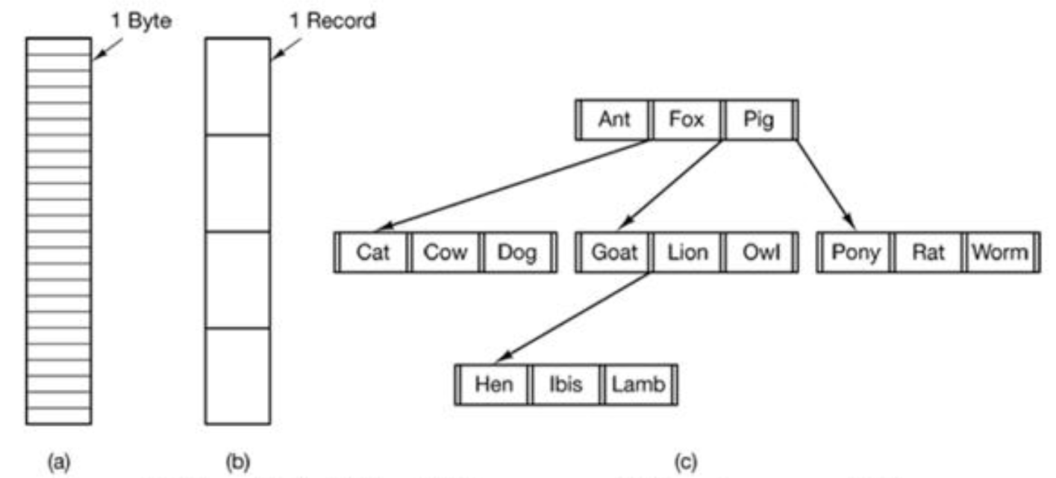
Fig : (a) Byte sequence (b) Record sequence (c) Tree structure

Slide 5
File Type
File type refers to the ability of the operating system to distinguish different types of file such as text files source files and binary files etc.
Many operating systems support many types of files.
Operating system like MS-DOS and UNIX have the following types of files:
i. Ordinary files/ Regular files:
These are the files that contain user information.
These may have text, databases or executable program.
The user can apply various operations on such files like add, modify, delete or even remove the entire file.
ii. Directory files:
These files contain list of file names and other information related to these files.
Directories are system files for maintaining the structure of the file system.
iii. Special files
These files are also known as device files.
These files represent physical device like disks, terminals, printers, networks, tape drive etc.

Slide 6
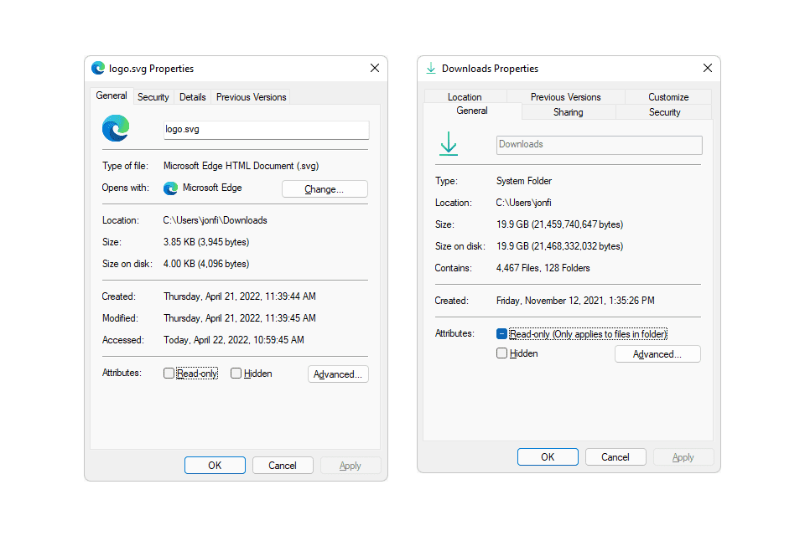
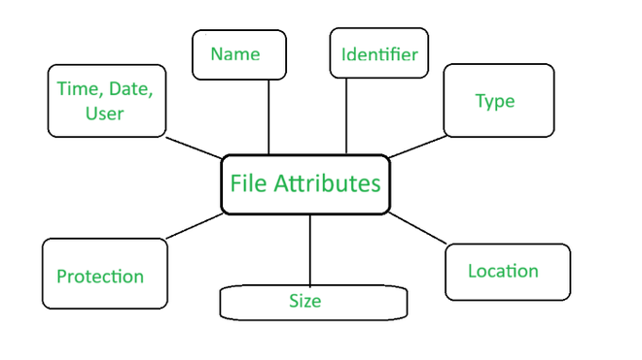
File Attributes
Every file has a name and its data.
In addition all operating systems associate other information with each file such as the date and time the file was created and the file’s size.

Slide 7
File operations
Some common operations of file are:
Create
Delete
Open
Close
Read
Write
Append
Rename

Slide 8
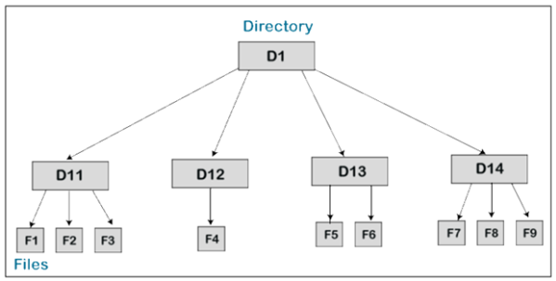
Directories:
A Directory is the collection of the correlated files on the disk.
In simple words, a directory is like a container which contains file and folder.
In a directory, we can store the complete file attributes or some attributes of the file.

Slide 9
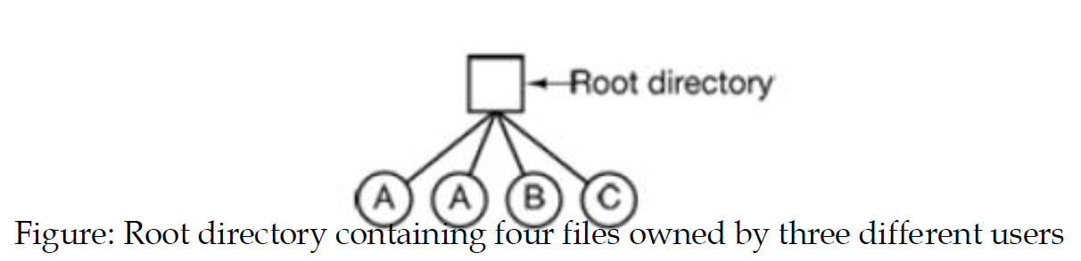
Single-Level Directory Systems:
The simplest form of directory system is having one directory containing all the files.
This directory is sometimes called root directory.
On early personal computers, this system was common.
The world’s first supercomputer, the CDC 6600, also had only a single directory for all files.
Drawback: This system is not applicable in multiple user environments because multiple users may want to create file with same name which is not supported

Slide 10
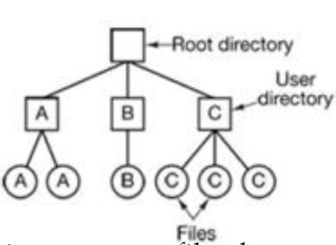
Two-level Directory Systems
To avoid conflicts caused by different users choosing the same file name for their own files, two-level directory systems can be used.
Here, users are given their own directories within root directory.
Drawback - Users cannot make sub-directories with their directory.

Slide 11
Hierarchical Directory Systems
The two-level hierarchy is not satisfactory for users with a large number of files who want to store theses files in different subdirectories by making logical groups of files.
For example, a user may want to store music files in one directory, personal data into another directory, and study materials in third directory and so on.
Hierarchical directory systems allow users to group their files in natural way by using tree like hierarchy.
Here, users can create any number of sub-directories within their directory and can also create subdirectories of subdirectories.

Slide 12
File System Layout

Slide 13
Introduction
File System: Fundamental component of operating systems managing how data is stored and retrieved.
File System Layout: Organizes files, directories, and metadata on storage devices.

Slide 14
1. Partitioning
Definition
Partitioning: Dividing a storage device into distinct sections or partitions.
Characteristics
Logical Separation: Each partition appears as a separate entity.
Allocation of Space: Allocation of specific storage capacity to each partition.
Types of Partitions
Primary Partition: Holds the OS and is bootable.
Extended Partition: Contains logical drives, not bootable on its own.

Slide 15
2. File Allocation Table (FAT) Layout
Definition
FAT Layout: Used in file systems like FAT16 and FAT32.
Characteristics
File Allocation Table: Stores information about file allocation status.
Clusters: Basic units for storing data, managed by the FAT.
Components
Boot Sector: Contains information about the file system.
File Allocation Table: Maps clusters to files.
Root Directory: Entry point for file and directory information.

Slide 16
3. Master File Table (MFT) Layout
Definition
MFT Layout: Used in NTFS (New Technology File System).
Characteristics
Master File Table: Central database storing information about files and directories.
Attributes: Metadata associated with each file record.
Components
MFT Header: Contains information about the MFT structure.
File Records: Individual entries for files and directories.
Data Runs: Describes the location of file data on the disk.

Slide 17
4. Inode-Based Layout
Definition
Inode-Based Layout: Used in Unix-like file systems (e.g., ext4).
Characteristics
Inode: Data structure storing metadata about a file.
Data Blocks: Actual storage space for file content.
Components
Inode Table: Collection of inodes.
Data Blocks: Storage blocks containing actual file data.

Slide 18
5. Hierarchical Directory Structure
Definition
Directory Structure: Organization of files and directories in a hierarchical manner.
Characteristics
Tree Structure: Directories, subdirectories, and files arranged in a tree.
Navigation: Paths help navigate through the structure.
Components
Root Directory: Top-level directory.
Subdirectories: Nested directories.
Files: Data or executable programs.

Slide 19
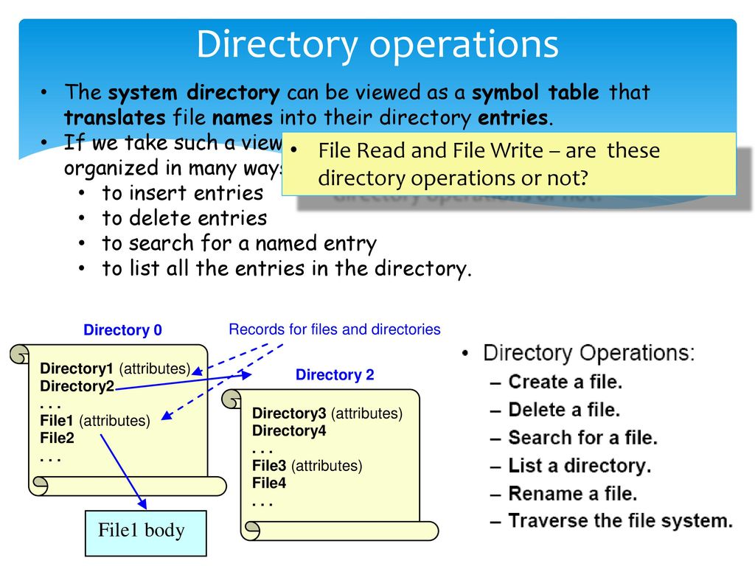

Slide 20
File Paths in a File System

Slide 21
Introduction
File Path: A string of characters used to identify the location of a file or directory in a file system.
Importance: Essential for navigating and accessing files within the file system.

Slide 22
1. Components of a File Path
Definition
File Path Structure: Comprises various components that identify the file's location.
Components
Root Directory: The top-level directory in a file system.
Directories (Folders): Subdirectories leading to the file.
File Name: The actual name of the file.

Slide 23
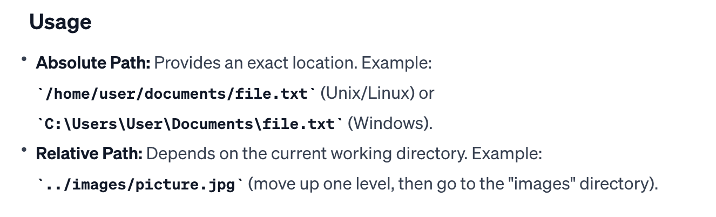
2. Absolute vs. Relative Paths
Definition
Absolute Path: Specifies the full path from the root directory.
Relative Path: Specifies the path relative to the current working directory.

Slide 24
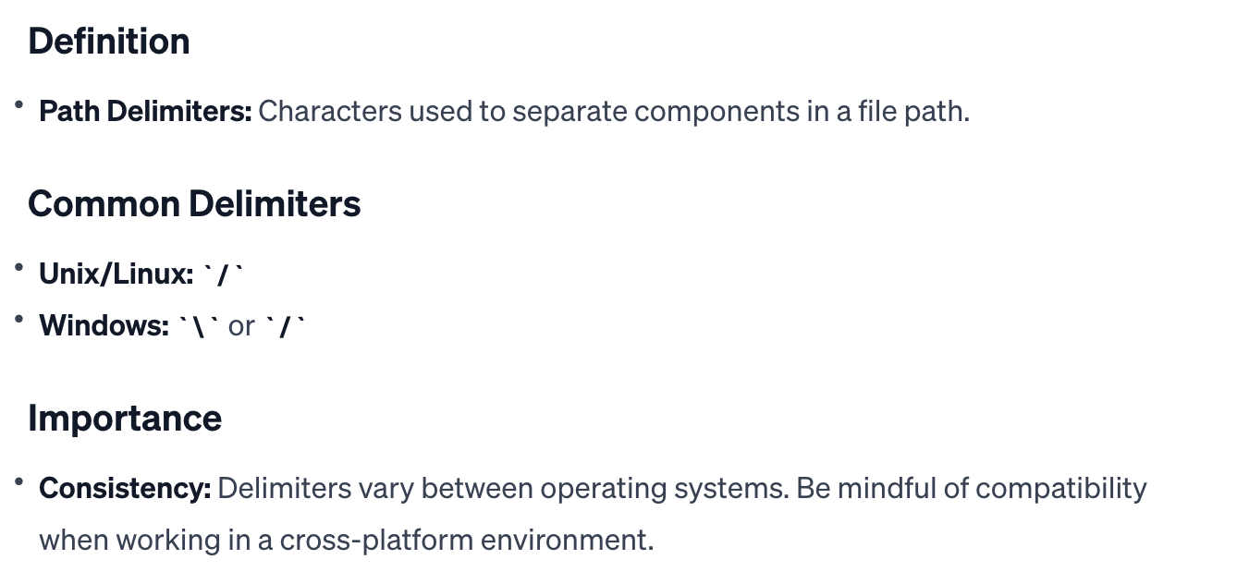
3. Path Delimiters

Slide 25
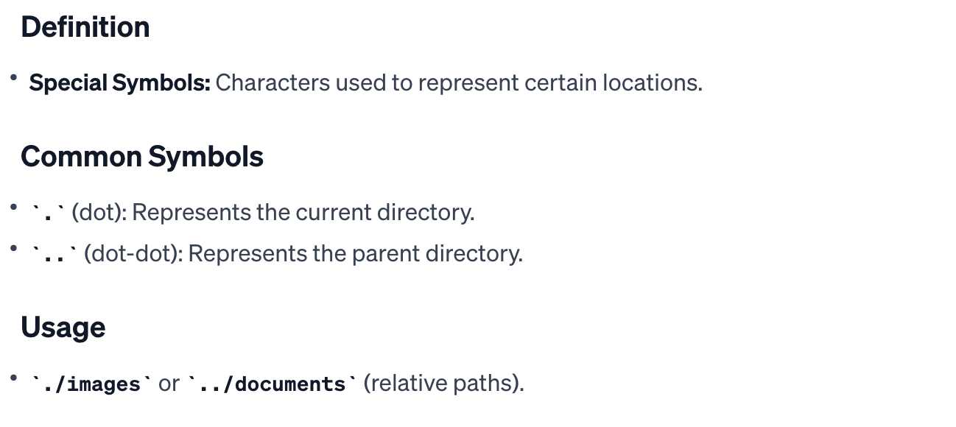
4. Special Symbols in Paths

Slide 26
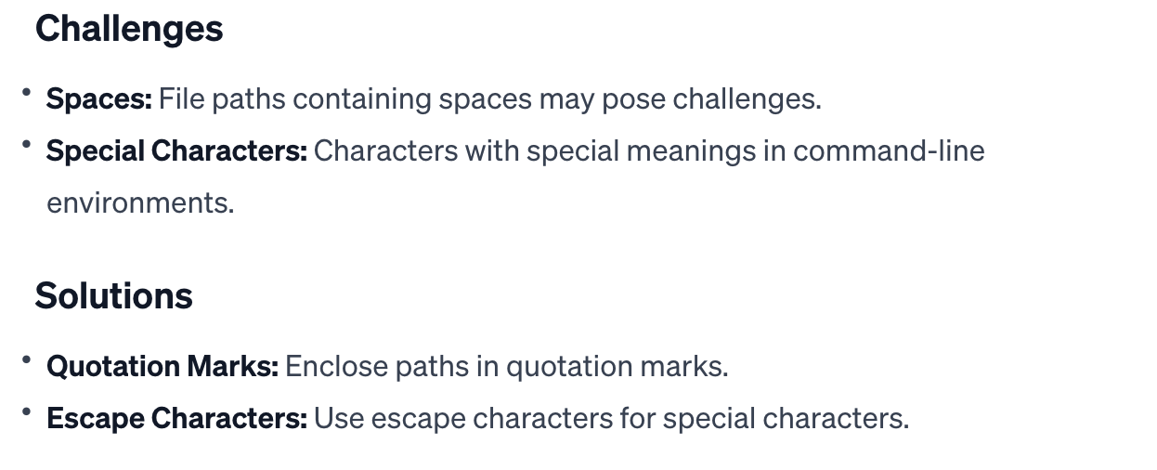
5. Handling Spaces and Special Characters

Slide 27
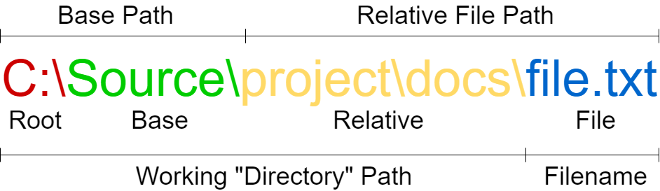

Slide 28
File Access Mechanisms: Sequential, Direct, and Indexed

Slide 29
Introduction
File Access Mechanisms: Methods used to read and write data in files.
Importance: File access mechanisms influence how data is organized and retrieved.

Slide 30
Sequential Access
Definition
Orderly Reading/Writing: Data is processed in a linear sequence, one record at a time.
Characteristics
Start to End: Accessed from the beginning to the end of the file.
No Random Access: No direct jumping to a specific record without reading prior records.

Slide 31
Sequential Access
Use Cases
Tape Storage: Suited for devices like magnetic tapes.
Simple Data Processing: Effective for simple, ordered data processing.
Advantages and Disadvantages
Advantages: Simplicity, suitable for large datasets.
Disadvantages: Inefficient for random access, especially with large files.

Slide 32
Direct Access (Random Access)
Use Cases
Databases: Ideal for quick retrieval of specific records.
Disk Storage: Suited for systems with fast access to specific locations.
Advantages and Disadvantages
Advantages: Efficient for quick access to specific records.
Disadvantages: Complexity, overhead of maintaining indexing structures.

Slide 33
Indexed Access
Definition
Combination of Sequential and Direct Access: Uses an index table for quick access to specific records.
Characteristics
Index Table: Maintains pointers to record locations.
Sequential Component: Index provides a reference to the position in the file.

Slide 34
Indexed Access
Use Cases
Large Databases: Efficient for databases with a mix of sequential and random access needs.
Information Retrieval Systems: Commonly used for search and retrieval applications.
Advantages and Disadvantages
Advantages: Balances efficiency and flexibility.
Disadvantages: Increased complexity, requires maintenance of index structures.

Slide 35
Direct Access (Random Access)
Definition
Arbitrary Access: Data can be read or written directly at any location within the file.
Characteristics
Indexed or Relative: Achieved through indexing or relative addressing.
Random Access: Allows jumping to any record without reading prior records.

Slide 36
Implementing Files
1. Contiguous Allocation:
Contiguous Allocation requires that all blocks of a file be kept together contiguously.
Performance is very fast, because reading successive blocks of the same file generally requires no movement of the disk heads.

Slide 37
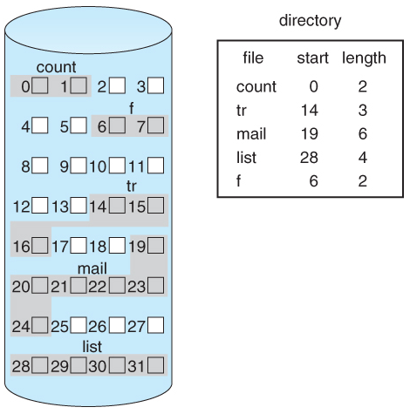
Figure - Contiguous allocation of disk space.

Slide 38
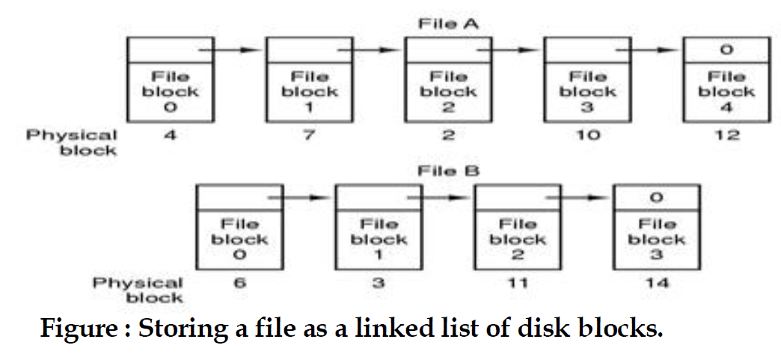
2. Linked List Allocation
In this strategy blocks of a file are represented using linked lists.
Each block contains data and a pointer to the next block.
The size of the file does not have to be known (unlike a contiguous file allocation scheme).
When more space is required for a file, any block can be allocated from the free block list.

Slide 39
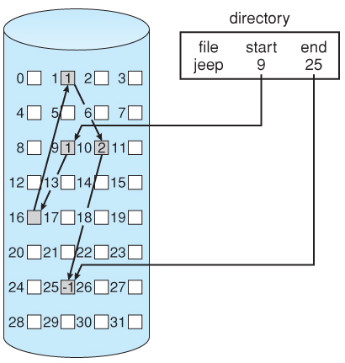

Slide 40
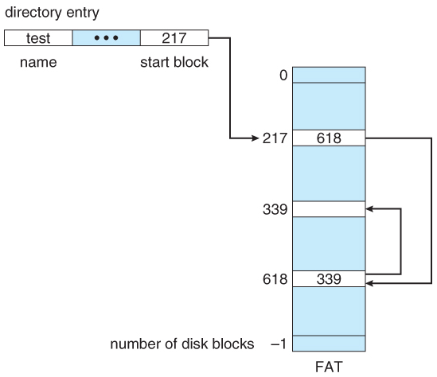
3. Linked List Allocation Using a Table in Memory
Also known as File Allocation Table.
FAT used by DOS is a variation
of linked allocation, where all the
links are stored in a separate table
at the beginning of the disk.

Slide 41
4. Indexed Allocation
Indexed Allocation (I-node) combines all of the indexes for accessing each file into a common block ( for that file ), as opposed to spreading them all over the disk or storing them in a FAT table.
Each file has its own index block.
All the attributes for the file are stored in an i-node entry, which is loaded into memory when the file is opened.

Slide 42
